Slide 1
Devoxx France 2021
sample presentation
Nicolas Martignole @nmartignole
Zouheir Cadi @zouheircadi
Antonio Goncalves @agoncal

Slide 2
Welcome to Devoxx France

Slide 3
Roadmap
This is a slide without background images.
You must load and install 2 Fonts on your system :
Montserrat (https://www.fontsquirrel.com/fonts/montserrat)
Open Sans (https://www.fontsquirrel.com/fonts/open-sans)

Slide 4
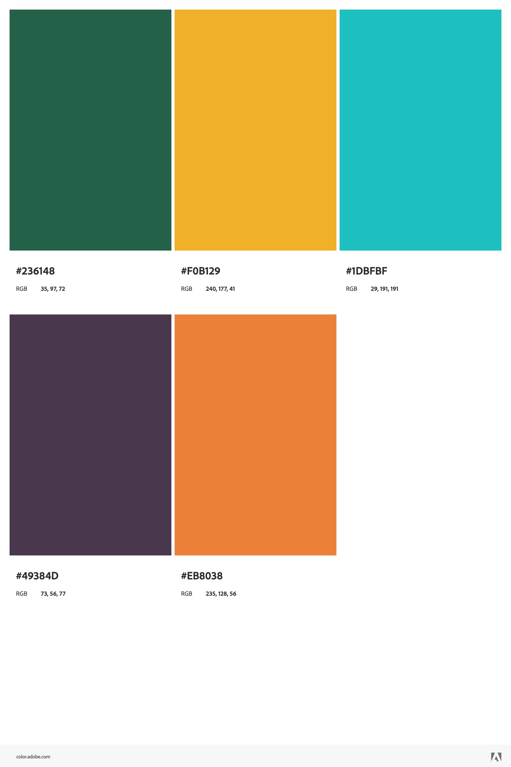
Devoxx FR 2022 colors
See online https://color.adobe.com/Devoxx-FR-2022-v2-color-theme-19678356
Color 1 #236148
Color 2 #F0B129
Color 3 #1DBFBF
Color 4 #49384D
Color 5 #EB8038

Slide 5

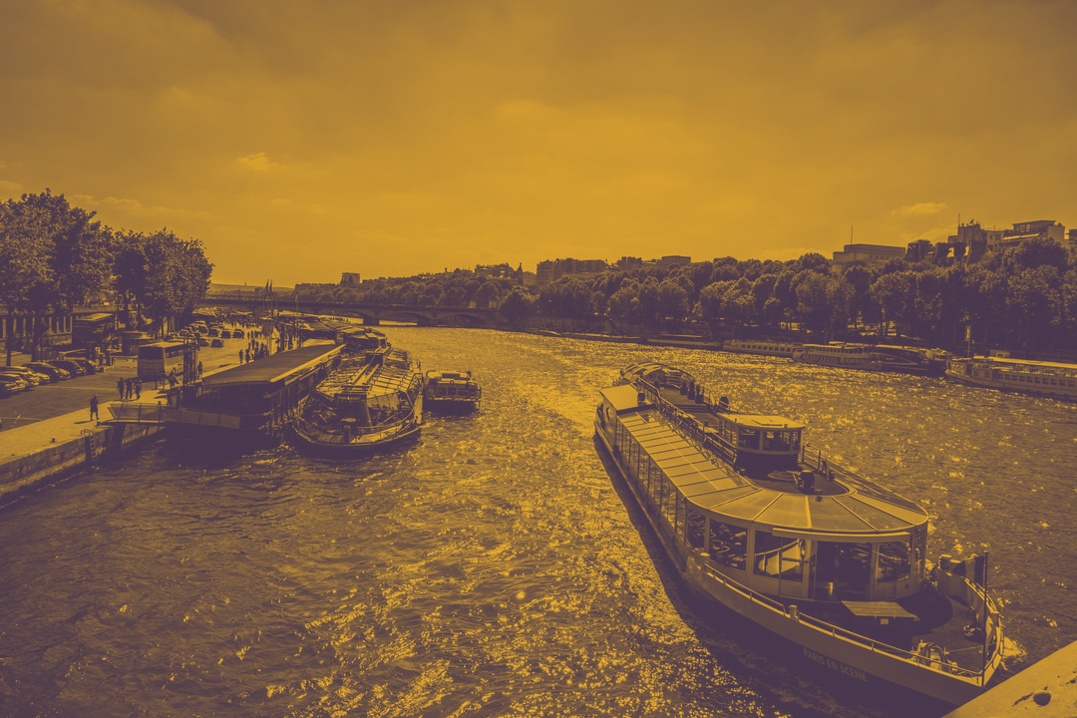
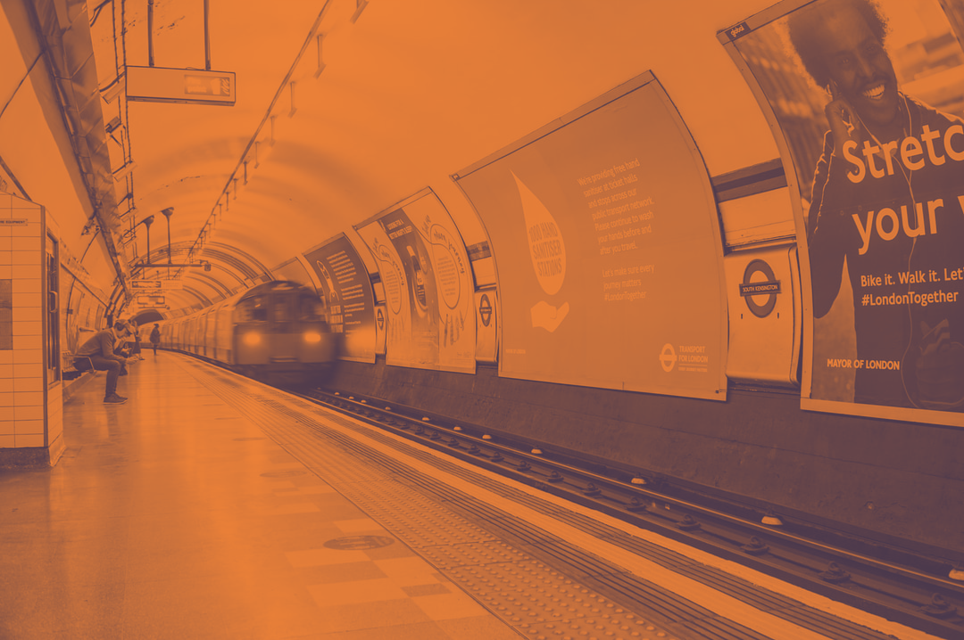

Slide 7
Show me shome code !
Try to keep a font size as big as possible. Remember also that too much code on one slide is useless. The audience reads this texte and does not listen to your presentation anymore. Try to split on different slides your presentation.
If you show some code : BIG FONT please
Ask the audience and confirm that they can read from far far away…

Slide 8
Show some code
Using transparency on font

Slide 9
127.0.0.1:6363[2]> zadd hackers 1953 "Richard Stallman"
(integer) 1
127.0.0.1:6363[2]> zadd hackers 1969 "Linus"
(integer) 1
127.0.0.1:6363[2]> zadd hackers 1912 "Alan turing"
(integer) 1
127.0.0.1:6363[2]> zrange hackers 0 -1
1) "Alan turing"
2) "Richard Stallman"
3) "Linus"
127.0.0.1:6363[2]> zrange hackers 0 -1 withscores
1) "Alan turing"
2) "1912"
3) "Richard Stallman"
4) "1953"
5) "Linus"
6) "1969"
127.0.0.1:6363[2]> zrangebyscore hackers 1910 1940
1) "Alan turing"

Slide 10
127.0.0.1:6363[2]> zadd hackers 1953 "Richard Stallman"
(integer) 1
127.0.0.1:6363[2]> zadd hackers 1969 "Linus"
(integer) 1
127.0.0.1:6363[2]> zadd hackers 1912 "Alan turing"
(integer) 1
127.0.0.1:6363[2]> zrange hackers 0 -1
1) "Alan turing"
2) "Richard Stallman"
3) "Linus"
127.0.0.1:6363[2]> zrange hackers 0 -1 withscores
1) "Alan turing"
2) "1912"
3) "Richard Stallman"
4) "1953"
5) "Linus"
6) "1969"
127.0.0.1:6363[2]> zrangebyscore hackers 1910 1940
1) "Alan turing"

Slide 11
127.0.0.1:6363[2]> zadd hackers 1953 "Richard Stallman"
(integer) 1
127.0.0.1:6363[2]> zadd hackers 1969 "Linus"
(integer) 1
127.0.0.1:6363[2]> zadd hackers 1912 "Alan turing"
(integer) 1
127.0.0.1:6363[2]> zrange hackers 0 -1
1) "Alan turing"
2) "Richard Stallman"
3) "Linus"
127.0.0.1:6363[2]> zrange hackers 0 -1 withscores
1) "Alan turing"
2) "1912"
3) "Richard Stallman"
4) "1953"
5) "Linus"
6) "1969"
127.0.0.1:6363[2]> zrangebyscore hackers 1910 1940
1) "Alan turing"

Slide 12
127.0.0.1:6363[2]> zadd hackers 1953 "Richard Stallman"
(integer) 1
127.0.0.1:6363[2]> zadd hackers 1969 "Linus"
(integer) 1
127.0.0.1:6363[2]> zadd hackers 1912 "Alan turing"
(integer) 1
127.0.0.1:6363[2]> zrange hackers 0 -1
1) "Alan turing"
2) "Richard Stallman"
3) "Linus"
127.0.0.1:6363[2]> zrange hackers 0 -1 withscores
1) "Alan turing"
2) "1912"
3) "Richard Stallman"
4) "1953"
5) "Linus"
6) "1969"
127.0.0.1:6363[2]> zrangebyscore hackers 1910 1940
1) "Alan turing"

Slide 13
Live Demo

Slide 14
Merci / Thanks you

Slide 15
Facts and numbers
10th Anniversary
220 speakers with a badge
2900 attendees
The speaker’s dinner is on Thursday. Make sure to register. A valid speaker’s badge (purple) is required. No access for green badge (Combi). Thanks for your understanding

Slide 16
Less code is less bug

Slide 17

I want cool images
You can generate Dualtone photos quickly on https://duotone.shapefactory.co/?f=eb8038&t=49384d&q=subway&i=Zi8T2OwJf44

Slide 20
https://duotone.shapefactory.co/?f=eb8038&t=49384d&q=subway&i=Zi8T2OwJf44

Slide 21
https://duotone.shapefactory.co/?i=ELy8RcnCgEo&f=313741&t=6bb884&q=wave

Slide 22
Why less slides is better than more slides
Devoxx France runs on 3 days
Audience loves live coding and demo
Too much bullet points is super boring
More text : less concentration from the audience that will just read your slides
So this is exactly what you should not do

Slide 23
Pourquoi peu de diapositives c’est mieux
Devoxx France se déroule sur 3 jours
Le public préfère les démonstrations et l’écriture de code en direct
Trop de points avec des puces c’est ennuyant
Plus il y a de texte à lire sur vos diapos, moins l’audience vous écoute
Si vos slides peuvent vous remplacer, alors vous ne servez à rien comme orateur
Imaginez que votre ensemble de diapos ne doivent pas pouvoir vivre sans vous, sans votre présentation et votre contenu
Merci donc de ne PAS faire comme ce slide à mourir

Slide 24
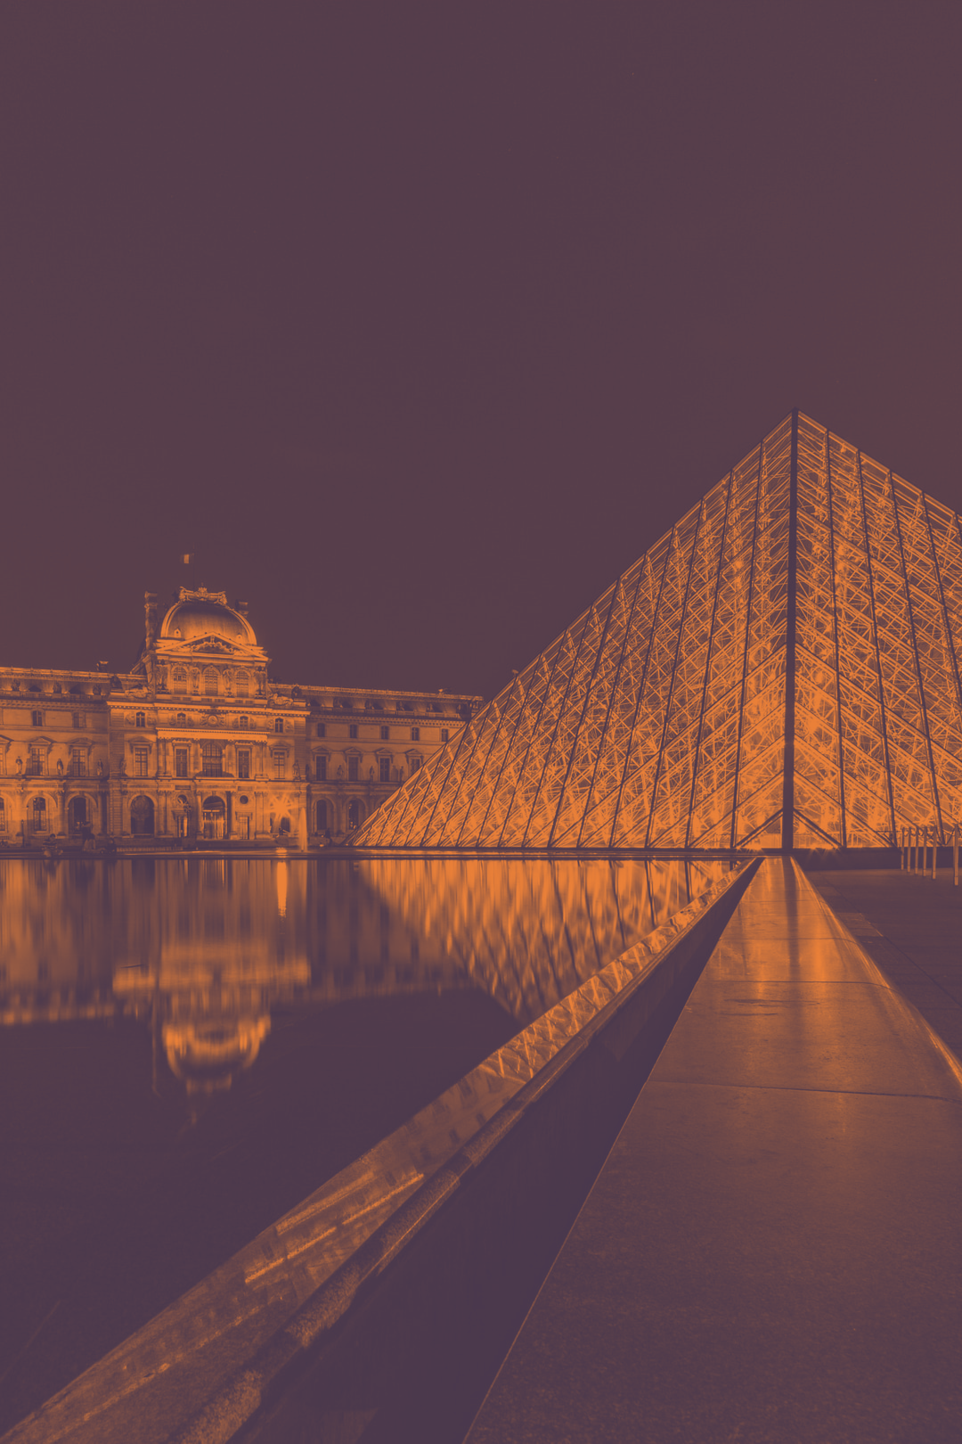
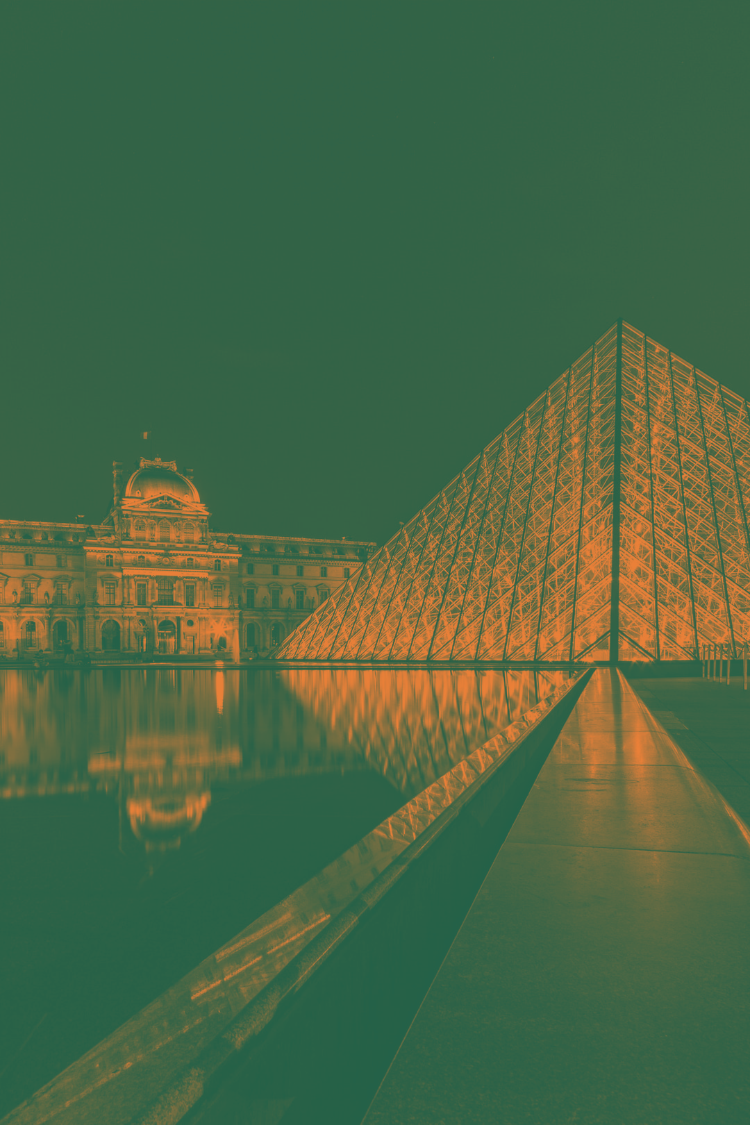
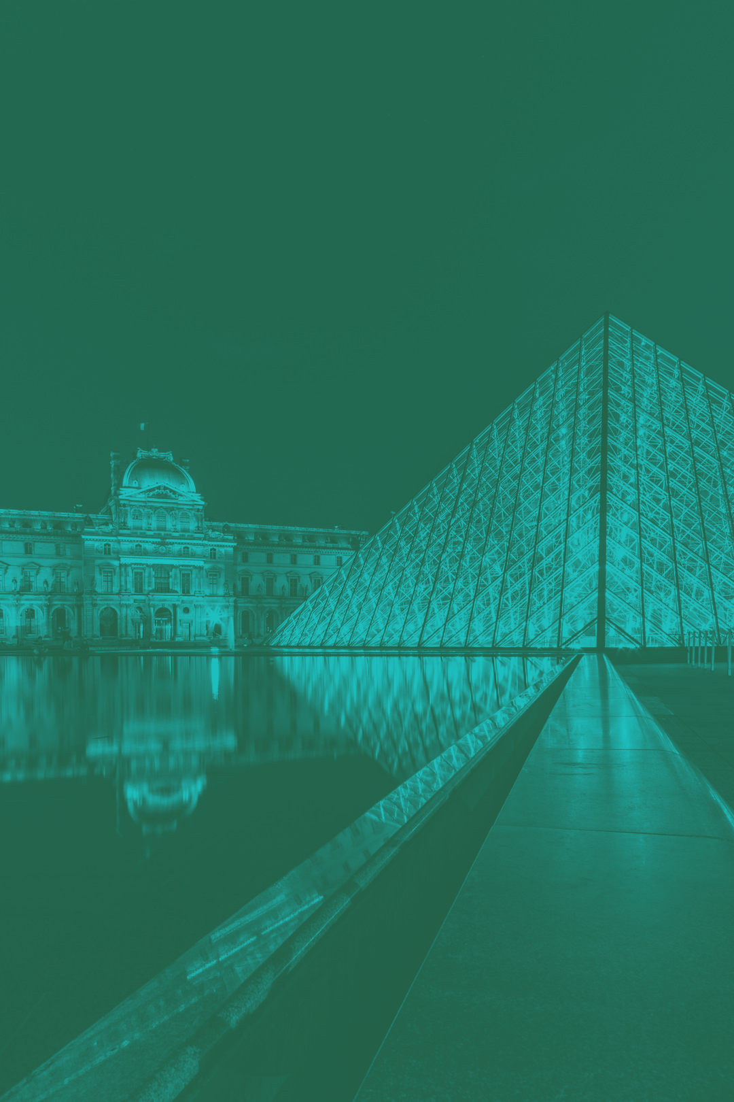

Slide 25
Screen capture
https://cfp.devoxx.fr

Slide 26
Devoxx FR preview
Here are just a few photos from Devoxx France so that you get a better idea of what you’re about to live
Voici quelques photos de Devoxx France afin de vous donner une idée de ce que vous vous apprêtez à vivre…

Slide 27
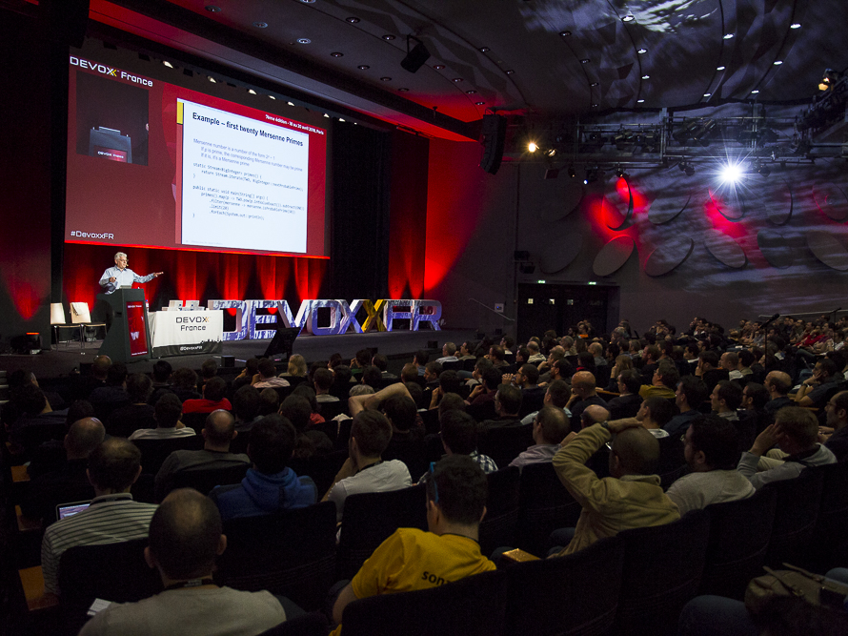

Slide 28
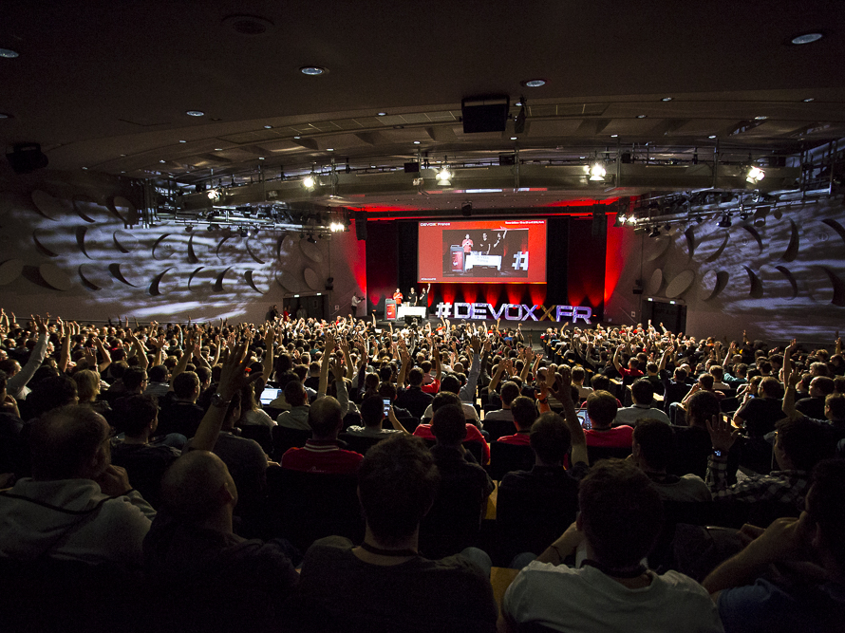

Slide 29
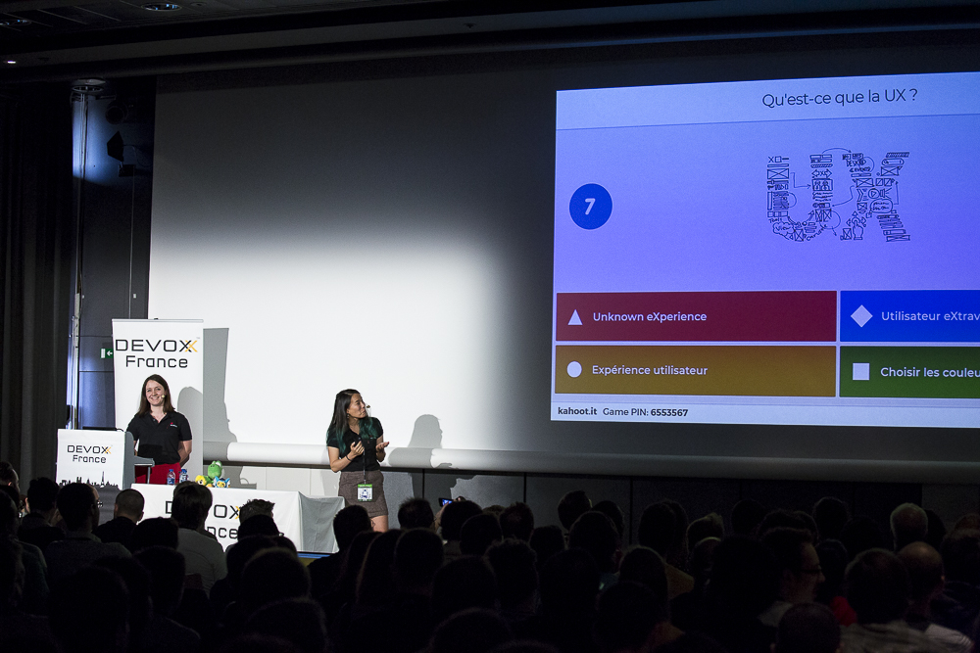
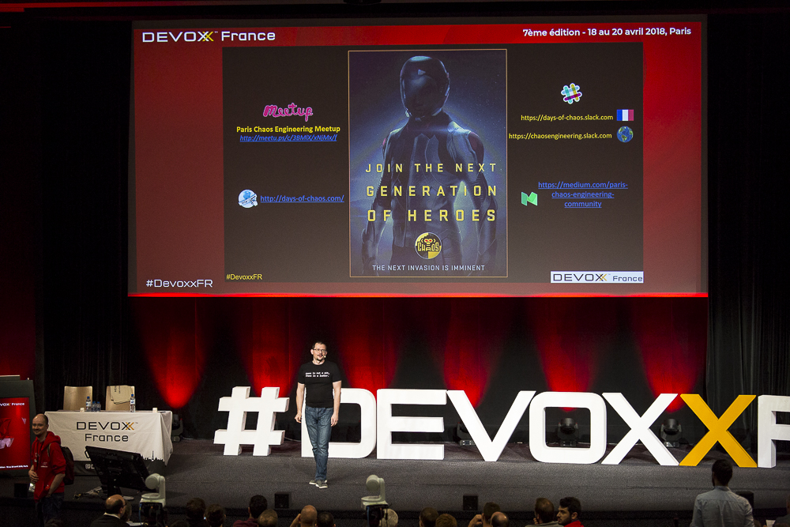
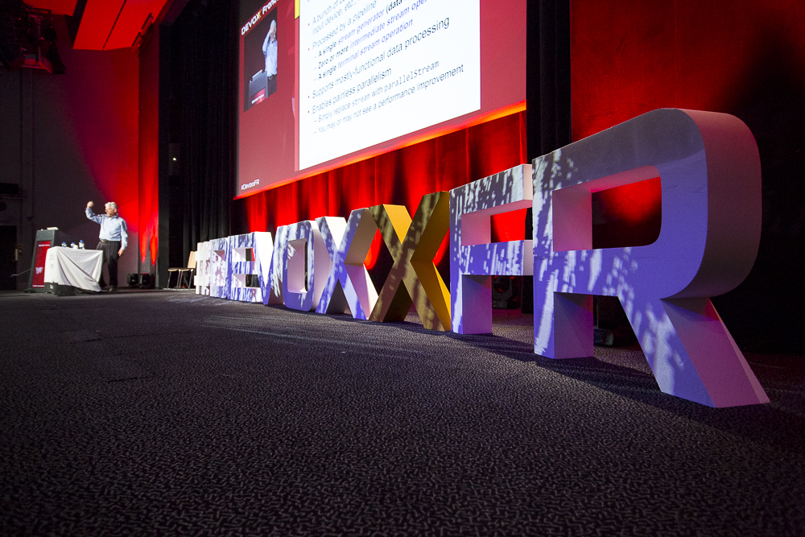

Slide 30
Thanks
Contribute and propose other templates format on
https://github.com/quantixx/template-presentation
Open Office, Powerpoint, Reveal.JS…

